Slide 1


K.RAMAKRISHNAN COLLEGE OF TECHNOLOGY (AUTONOMOUS), TRICHY
ANALYSING EXAM SCORES USING DESCRIPTIVE STATISTICS
PRESENTED BY
PADMA PRIYA S – ADB23080

Slide 2
PRESENTATION OVERVIEW
Problem Identification
Objective
Proposed system
Block diagram of proposed system
machine learning used
Advantages of proposed system
Modules

Slide 3
PROBLEM IDENTIFICATION
Educational institutions often struggle with analyzing student performance efficiently. Traditional methods of evaluation do not provide in-depth insights into trends in student performance, making it difficult for educators to identify areas of improvement. The absence of automated statistical analysis limits decision-making.
2/7/20

Slide 4
OBJECTIVE
To analyze student exam scores using descriptive statistics (Mean, Median, Mode).
To identify patterns in student performance based on statistical measures.
To develop an automated system that processes student scores efficiently.
To visualize performance trends using graphs and charts.

Slide 5
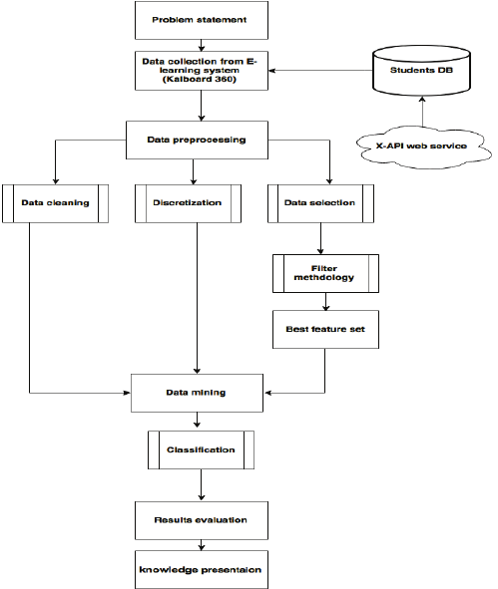
PROPOSED SYSTEM
BLOCK DIAGRAM

Slide 6
MACHINE LEARNING USED
Regression Models (Linear Regression, Decision Trees): To predict future exam performance.
Clustering (K-Means, Hierarchical Clustering): To group students based on performance patterns.
Classification (Random Forest, SVM): To categorize students into different performance levels (e.g., High, Medium, Low).

Slide 7
ADVANTAGES OF PROPOSED SYSTEM
1. Automated Analysis
Eliminates the need for manual calculations of mean, median, and mode.
Reduces human error in statistical analysis.
2. Improved Decision-Making
Helps educators identify trends in student performance.
Enables targeted interventions for students needing improvement.
3. Efficient Data Processing
Quickly processes large datasets of student scores.
Saves time compared to traditional evaluation methods.
4. Enhanced Data Visualization
Generates graphical representations (histograms, boxplots) for better insights.
Makes it easier to identify outliers and performance patterns.

Slide 8
ADVANTAGES OF PROPOSED SYSTEM
5. Scalability
Can handle increasing amounts of data with minimal modifications.
Easily adaptable for different institutions or courses.
6. Optional Machine Learning Integration
Predicts student performance trends based on historical data.
Helps in early identification of students at risk of poor performance
7. Report Generation
Provides automated summary reports for teachers, students, and administrators.
Enables data-driven decision-making.

Slide 9
MODULES OF THE SYSTEM
1. Data Input Module
2. Data Preprocessing Module
3. Statistical Computation Module
4. Data Visualization Module
5. Machine Learning Module
6. Report Generation Module

Slide 10
MODULES OF THE SYSTEM
1. Data Input Module
Accepts exam scores from different sources (CSV file, database, manual entry).
2. Data Preprocessing Module
Cleans and organizes data for analysis.
3. Statistical Computation Module
Computes Mean, Median, and Mode.

Slide 11
MODULES OF THE SYSTEM
4. Data Visualization Module
Generates histograms, boxplots, and bar charts for better understanding.
5. Machine Learning Module (Optional)
Predicts future student performance trends.
6. Report Generation Module
Generates summary reports with findings and recommendations.

Slide 12
RESULTS
summary(data)
X Hindi English Science Maths
Min. : 0.0 Min. : 0.00 Min. : 0.00 Min. : 0.00 Min. : 0.00
1st Qu.:249.8 1st Qu.:26.00 1st Qu.:26.00 1st Qu.:25.00 1st Qu.:25.75
Median :499.5 Median :53.00 Median :50.50 Median :50.00 Median :49.00
Mean :499.5 Mean :51.65 Mean :50.11 Mean :49.44 Mean :49.55
3rd Qu.:749.2 3rd Qu.:77.00 3rd Qu.:75.00 3rd Qu.:73.25 3rd Qu.:74.00
Max. :999.0 Max. :99.00 Max. :99.00 Max. :99.00 Max. :99.00
History Geograpgy Total Results Div
Min. : 0.00 Min. : 0.00 Min. :103.0 Min. :0.00 Min. :0.000
1st Qu.:24.00 1st Qu.:26.00 1st Qu.:254.0 1st Qu.:0.00 1st Qu.:1.000
Median :49.00 Median :49.00 Median :296.0 Median :0.00 Median :2.000
Mean :49.03 Mean :50.03 Mean :299.8 Mean :0.35 Mean :1.856
3rd Qu.:73.25 3rd Qu.:75.00 3rd Qu.:349.2 3rd Qu.:1.00 3rd Qu.:3.000
Max. :99.00 Max. :99.00 Max. :505.0 Max. :1.00 Max. :3.000

Slide 13
RESULTS
Standard deviation of scores
Hindi English Science Maths History Geograpgy Total
29.47191 28.04850 28.92111 28.63245 28.76975 28.71027 71.86524
Correlation matrix
Hindi English Science Maths History Geograpgy
Hindi 1.00000000 0.036454895 0.037615847 0.041239550 -0.024652488 -0.064189091
English 0.03645489 1.000000000 -0.022410890 -0.011268721 -0.001812014 0.052252624
Science 0.03761585 -0.022410890 1.000000000 0.056313623 0.005605054 0.028845817
Maths 0.04123955 -0.011268721 0.056313623 1.000000000 0.011524990 -0.001140353
History -0.02465249 -0.001812014 0.005605054 0.011524990 1.000000000 -0.022318004
Geograpgy -0.06418909 0.052252624 0.028845817 -0.001140353 -0.022318004 1.000000000

Slide 14
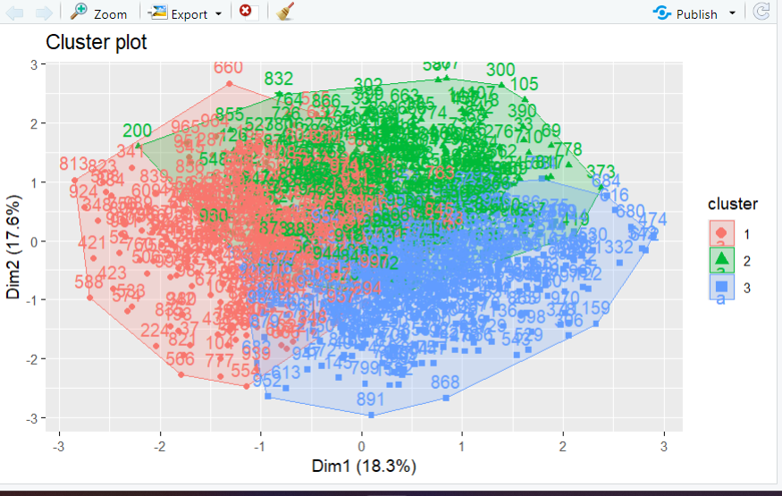
RESULTS

Slide 15
IMPLEMENTATION
The use of comments and descriptive captions ensures that the code is self-explanatory.
It demonstrates the use of functions from multiple libraries such as ggplot2 for plotting and knitr for creating formatted tables.
The descriptive statistics (mean, median, and mode) are computed using both base R functions and a custom helper function for mode calculation.

Slide 16
CONCLUSION
This R framework provides a structured, insightful approach to analyzing student performance. Statistical measures like mean, median, and mode offer key summaries of academic trends, while visualizations such as histograms and boxplots reveal distribution patterns and outliers. These tools help educators identify strengths, weaknesses, and performance gaps. The analysis supports data-driven decisions, guiding targeted interventions, curriculum planning, and future performance predictions. Ultimately, it turns raw exam data into clear, actionable insights to improve educational outcomes.

Slide 17
FUTURE SCOPE
This study provides a strong foundation for further exploration in the field of educational data analytics. In the future, the analysis can be enhanced by incorporating additional variables such as attendance records, socio-economic background, parental education levels, and learning behavior to improve prediction accuracy and depth of insight. Time-series analysis could be used to track student performance trends over multiple academic terms, enabling early identification of at-risk students. Additionally, the implementation of real-time dashboards using tools like R Shiny could help educators and administrators monitor performance dynamically and take timely actions. Automated alerts based on predictive models can also be developed to notify stakeholders when a student's performance deviates from expected patterns, supporting proactive academic
Performance.

Slide 18


